Slide 1
PCA on random selection of cells

Slide 2
OPLS-DA on random selection of cells

Slide 3
PCA on random selection of 20 cells/annotation

Slide 4
OPLS-DA on random selection of 20 cells/annotation

Slide 5
VIPs correlated to 11 annotations

Slide 6
PCA on Tc only

Slide 7
OPLS-DA on Tc annotations only

Slide 8
VIPs correlated to Tc annotations

Slide 9
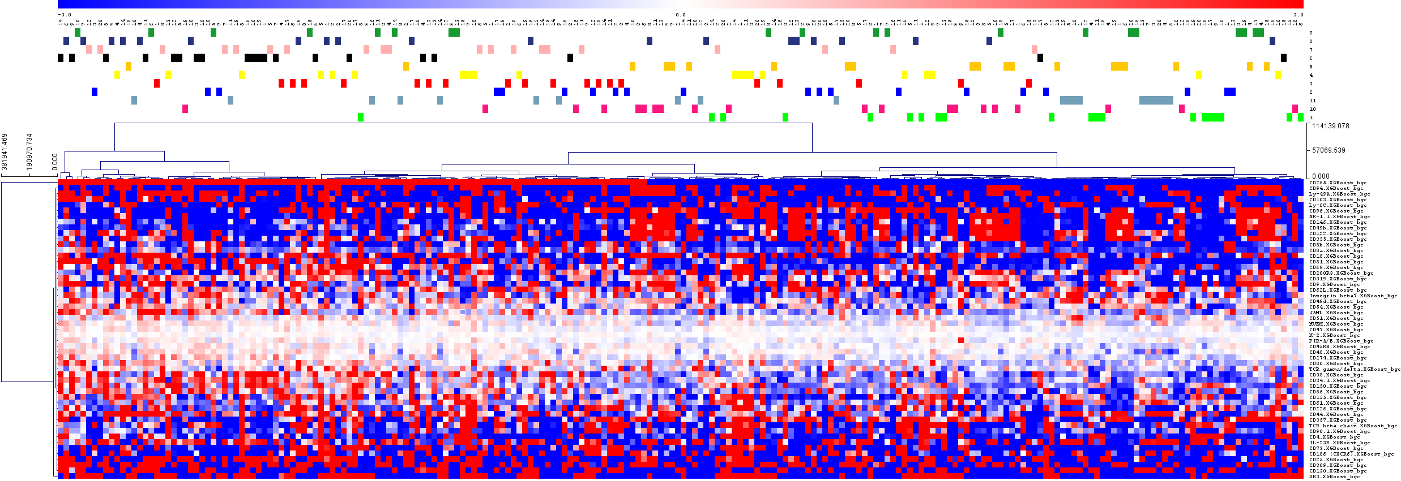
HCL of Tc VIPs on all annotations

Slide 10
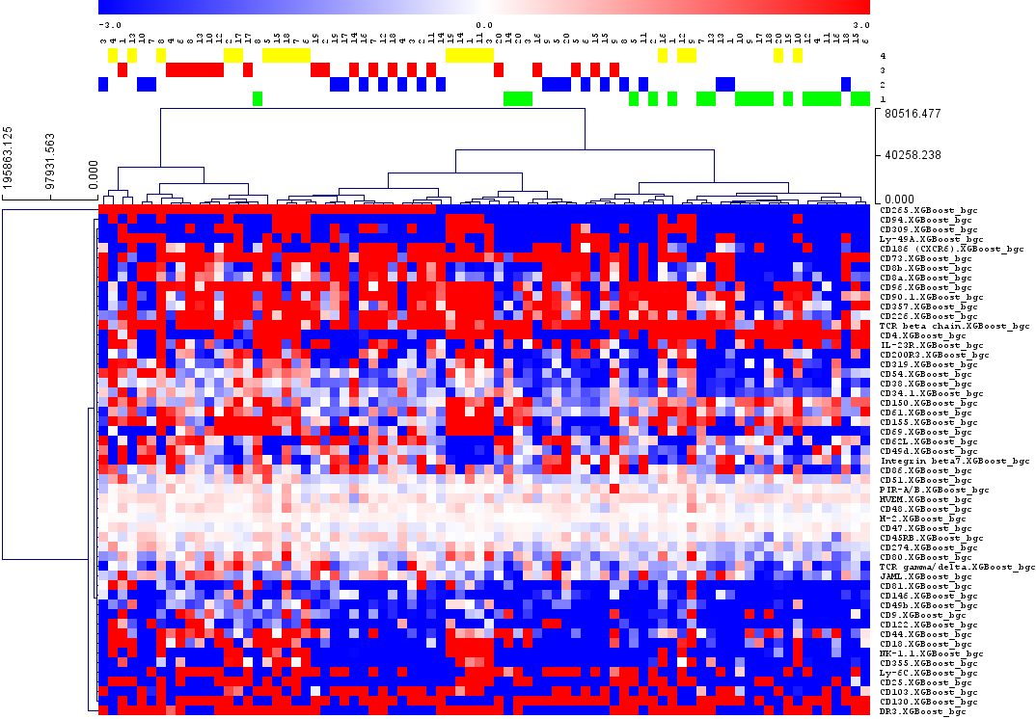
HCL of Tc VIPs on Tc annotations

Slide 11
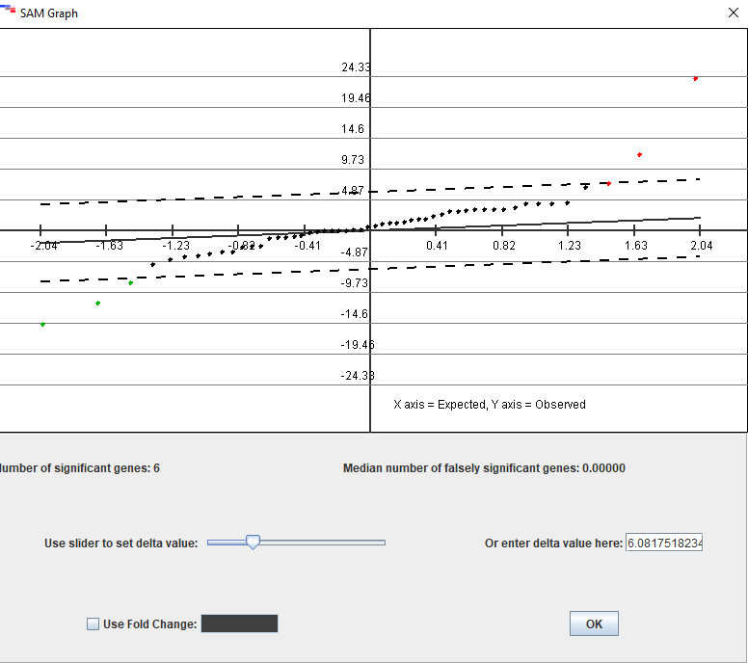
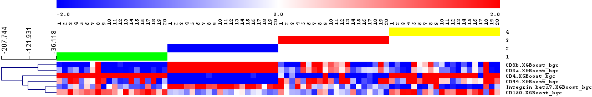
HCL of SAM selected variables (CD4 vs CD8 annotation)

Slide 12
PCA on randomly selected files

Slide 13
OPLS-DA on randomly selected files
R2X(cum) = .845
RYX(cum) = 0.779, Q2(cum) = .661

Slide 14
OPLS-DA on Tc annotations
R2X(cum) = .783
RYX(cum) = 0.924, Q2(cum) = .848
R(X)2 = 0.783 ; R(Y)2= 0.848

Slide 15
VIPs correlated to Tc annotations
Primary ID | M15.pq(corr)[1] | M15.pq(corr)[2]
CD103.XGBoost_bgc | -0.21681 | 0.800062
CD105.XGBoost_bgc | 0.0154831 | 0.821918
CD11c.XGBoost_bgc | -0.540116 | -0.245157
CD120b.XGBoost_bgc | -0.742953 | -0.283324
CD122.XGBoost_bgc | -0.907521 | -0.082577
CD130.XGBoost_bgc | 0.393468 | 0.628943
CD146.XGBoost_bgc | -0.549032 | 0.458082
CD150.XGBoost_bgc | 0.142539 | -0.834783
CD154.XGBoost_bgc | -0.36306 | -0.573103
CD155.XGBoost_bgc | -0.0173759 | -0.842705
CD157.XGBoost_bgc | -0.527703 | -0.256717
CD18.XGBoost_bgc | -0.382219 | -0.761554
CD2.XGBoost_bgc | -0.462975 | 0.185769
CD200.XGBoost_bgc | -0.157826 | -0.585725
CD200R3.XGBoost_bgc | -0.75275 | 0.152386
CD229 (Ly-9).XGBoost_bgc | -0.736121 | 0.311242
CD24.XGBoost_bgc | -0.0441086 | -0.761501
CD25.XGBoost_bgc | -0.0471398 | -0.773498
CD265.XGBoost_bgc | -0.753916 | 0.386052
CD274.XGBoost_bgc | -0.856436 | -0.139965
CD278.XGBoost_bgc | 0.41838 | -0.494304
CD301b.XGBoost_bgc | -0.467137 | 0.327642
CD317.XGBoost_bgc | 0.0549951 | -0.731329
CD319.XGBoost_bgc | -0.77154 | -0.46171
CD38.XGBoost_bgc | -0.660951 | -0.58641
CD4.XGBoost_bgc | 0.232152 | -0.821292
CD44.XGBoost_bgc | -0.0958875 | -0.942934
CD45RB.XGBoost_bgc | -0.326397 | 0.748816
CD47.XGBoost_bgc | 0.268996 | -0.788799
CD49b.XGBoost_bgc | -0.81625 | -0.182611
CD49d.XGBoost_bgc | 0.68671 | 0.236081
CD51.XGBoost_bgc | -0.346198 | -0.602137
CD54.XGBoost_bgc | -0.731282 | -0.251456
CD61.XGBoost_bgc | -0.0129834 | -0.859635
CD62L.XGBoost_bgc | 0.53953 | 0.711076
CD69.XGBoost_bgc | -0.741642 | -0.425962
CD73.XGBoost_bgc | -0.387344 | 0.626155
CD86.XGBoost_bgc | -0.345652 | 0.743207
CD8a.XGBoost_bgc | -0.0467591 | 0.954955
CD8b.XGBoost_bgc | -0.0995791 | 0.943573
CD9.XGBoost_bgc | -0.251693 | -0.665123
CD90.1.XGBoost_bgc | -0.624561 | 0.467652
CD94.XGBoost_bgc | -0.906257 | -0.253557
CD96.XGBoost_bgc | -0.703022 | -0.122165
DR3.XGBoost_bgc | -0.397855 | -0.585428
F4/80.XGBoost_bgc | -0.492679 | -0.539175
H-2.XGBoost_bgc | -0.546698 | 0.467001
IL-21R.XGBoost_bgc | 0.231861 | 0.700347
IL-23R.XGBoost_bgc | 0.218401 | -0.828371
IL-33Ralpha.XGBoost_bgc | -0.442164 | -0.346815
Integrin beta7.XGBoost_bgc | 0.268301 | 0.894117
JAML.XGBoost_bgc | -0.103509 | 0.813479
Ly-49A.XGBoost_bgc | -0.805142 | -0.0302778
NK-1.1.XGBoost_bgc | -0.854143 | -0.355291
NKG2D.XGBoost_bgc | -0.7755 | -0.207019
Plexin B2.XGBoost_bgc | -0.0673226 | -0.759856
Podoplanin.XGBoost_bgc | -0.626622 | 0.197562
RAE-1gamma.XGBoost_bgc | -0.506622 | -0.603746
SSEA-1.XGBoost_bgc | -0.780613 | 0.0931735
TCR beta chain.XGBoost_bgc | -0.0840227 | 0.68651

Slide 16
